Slide 1
Object oriented programming
Iván Guerrero Román

Slide 2
Session #19
Today’s topics
5. Graphical user interface (GUI)
a. Simple components to implement a GUI

Slide 3
Controls

Slide 4
Controls
Every user interface considers the following three main aspects −
UI elements − These are the core visual elements which the user eventually sees and interacts with.
Layouts − They define how UI elements should be organized on the screen and provide a final look and feel to the GUI (Graphical User Interface).
Behavior − These are events which occur when the user interacts with UI elements.

Slide 5
Common controls
JavaFX provides several classes in the package javafx.scene.control to create various GUI components (controls).
Label
A Label object is a component for placing text.
Button
This class creates a labeled button.
CheckBox
A CheckBox is a graphical component that can be in either an on(true) or off (false) state.
ListView
A ListView component presents the user with a scrolling list of text items.
TextField
A TextField object is a text component that allows for the editing of a single line of text

Slide 6
Common layouts
Layout panes (classes) provided by JavaFX exist in the package javafx.scene.layout.
HBox
The HBox layout arranges all the nodes in our application in a single horizontal row.
VBox
The VBox layout arranges all the nodes in our application in a single vertical column.
BorderPane
The Border Pane layout arranges the nodes in our application in top, left, right, bottom and center positions.

Slide 7
StackPane
The stack pane layout arranges the nodes in our application on top of another just like in a stack. The node added first is placed at the bottom of the stack and the next node is placed on top of it.
GridPane
The Grid Pane layout arranges the nodes in our application as a grid of rows and columns. This layout comes handy while creating forms using JavaFX.
FlowPane
The flow pane layout wraps all the nodes in a flow. A horizontal flow pane wraps the elements of the pane at its height, while a vertical flow pane wraps the elements at its width.

Slide 8
Behavior

Slide 9
Events
In general, whenever a user interacts with the application (nodes), an event is said to have been occurred.
Sample events
clicking on a button
moving the mouse
entering a character through keyboard
selecting an item from list
scrolling the page
The Event class of the package javafx.event is the base class for an event.

Slide 10
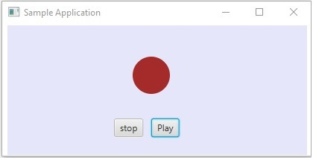
Every event consists of three elements:
Target: The node on which the evento occurred
Source: The source from which the evento was generated
Type: The type of evento occurred
Target: Play button
Source: Mouse
Type: Click

Slide 11
Handling events
The process to handle an event comprises the following steps:
Create an event handler (an object from the class EventHandler)
Subscribe the event to the target
Creating an EventHandler
EventHandler is an interface with one method: handle(T event)
Subscribing an event
All the nodes have a method called addEventFilter(Type, EventHandler)

Slide 12
Example
import javafx.scene.control.*;
import javafx.event.EventHandler;
import javafx.scene.input.MouseEvent;
public class MyControlsFX extends Application {
public void start(Stage stage) throws Exception {
Button bttnClick = new Button("Click");
EventHandler<MouseEvent> handler = new EventHandler<MouseEvent>() {
public void handle(MouseEvent e) {
//Do something
}
};
bttnClick.addEventFilter(MouseEvent.MOUSE_CLICKED, handler);
}
public static void main(String[] args) {
launch(args);
}

Slide 13
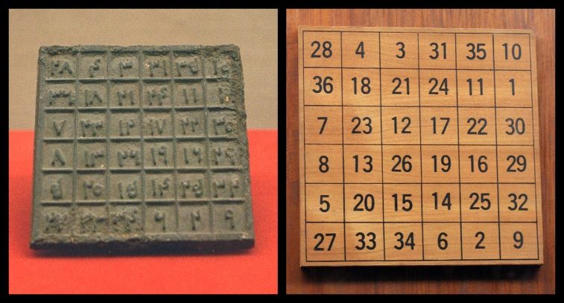
Exercise
A magic square is a 3 * 3 matrix in which numbers from 1 to 9 are placed so that adding the numbers of each row and each column gives the same result.
Write a program that reads numbers from a matrix and determines if they form a magic square.
Implement a graphical user interface to write the matrix.

Slide 14
Information resources
JavaFX API
https://docs.oracle.com/javase/8/javafx/api/toc.htm
JavaFX Tutorial
https://www.tutorialspoint.com/javafx/index.htm

Slide 15
Session #19
Today’s topics
5. Graphical user interface (GUI)
a. Simple components to implement a GUI

